Slide 1
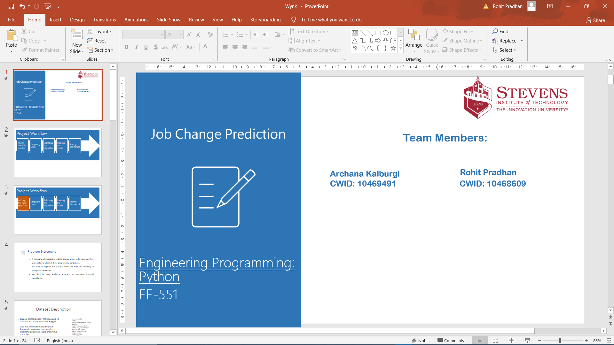


Team Members:
Archana Kalburgi
CWID: 10469491 CWID: 10468609
Rohit Pradhan
Notes:
hello everyone
i am archana
i am here with rohit to present our project “job change prediction” which is a binary classification.
we have implemented this using python and machine learning libraries

Slide 2
Project Workflow
Asking the right question
Preparing Data
Selecting the algorithm
Training the model
Testing the model
Notes:
the high level steps involved in this project are
framing the question
preparing data
selecting algorithm
training model
testing the model

Slide 3
Project Workflow
Asking the right question
Preparing Data
Selecting the algorithm
Training the model
Testing the model
Notes:
by asking the right question i mean, setting up the project hypothesis

Slide 4
Problem Statement
A company which is active in Data Science wants to hire people. They want to know which of these are potential candidates.
We need to explore the features which will help the company to categorize candidates.
We shall be using analytical approach to determine potential candidates.
Notes:
the aim of our project is to predict if a employee will stay or quit the company
the output of the algorithm will be
0 - employees will stay in the company
and 1 - means the employee will quit
in this project we have made use of numpy, pandas , sklearn packages

Slide 5
Project Workflow
Asking the right question
Preparing Data
Selecting the algorithm
Training the model
Testing the model
Notes:
This is the part of the project which utilises a lot of knowledge which we gained in python course
we have used map, filter, zip, iterators, lists, dictionaries to preprocess the data

Slide 6
Preprocessing
Map
Zip
Iterators
Lists
Dictionaries
Notes:
Map : to replace null values with variables
Filter : to remove the null values from the column
Reduction : to obtain mean and standard deviation
Iterators : we collected the columns we wanted to replace with another variable in a list and iterated through it to make the necessary changes
Dictionaries : we made use of dictionaries to store the accuracies of the algorithms we used and used it to derive plots

Slide 7
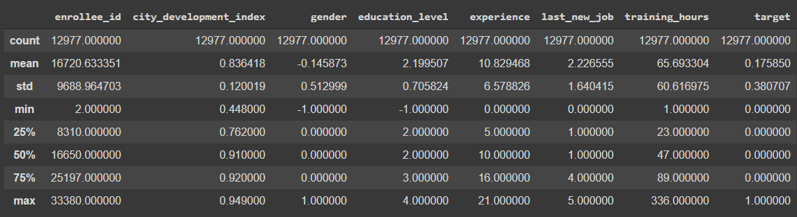
Exploratory Data Analysis
Summary of the dataset after cleaning
Notes:
so this is how our data looks like after preprocessing

Slide 8
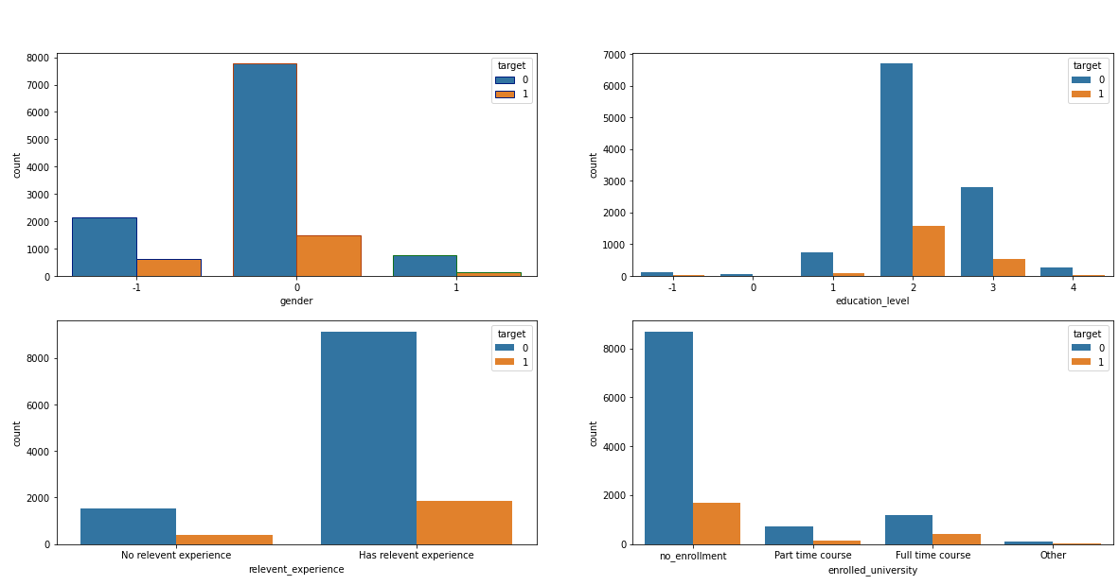
Exploratory Data Analysis - Bivariate
Feature Distribution based on Target
Notes:
we used matplotlib to understand the data better
these are plots of the features against the target variable

Slide 9
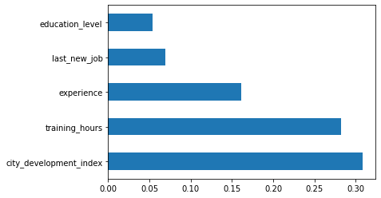
Best Features
Notes:
all this helped us to obtain the best features that helps us make the prediction

Slide 10
Summarizing EDA
Changed data type
Replaced null values
Label Encoding the necessary columns
Standardization of data
Found the correlation between all features and the target variable
Most contributing features
Notes:
to summarise,
all the concepts like map, reduce, filter, list, list slicing, dictionaries, tuples, classes, functions all were great help to work on this project.

Slide 11
Project Workflow
Asking the right question
Preparing Data
Selecting the algorithm
Training the model
Testing the model
Notes:
selecting the algorithms is the next steps

Slide 12
Classification Algorithms Using Sklearn Library
K Nearest Neighbor Classifier
Naive Bayes
Decision Tree Classifier
Random Forest Classifier
KNN
Naive Bayes
Algorithms
Decision Tree
Random Forest
Notes:
these are the algorithms we selected
and rohit would present from here on
thank you all for your time

Slide 13
Project Workflow
Asking the right question
Preparing Data
Selecting the algorithm
Training the model
Testing the model

Slide 14
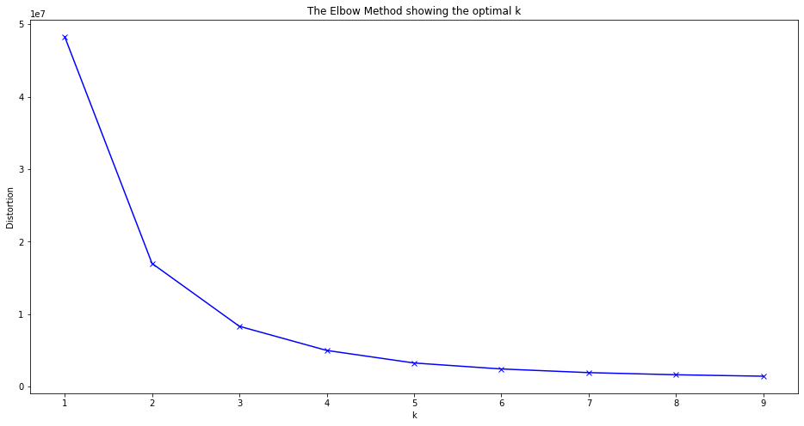
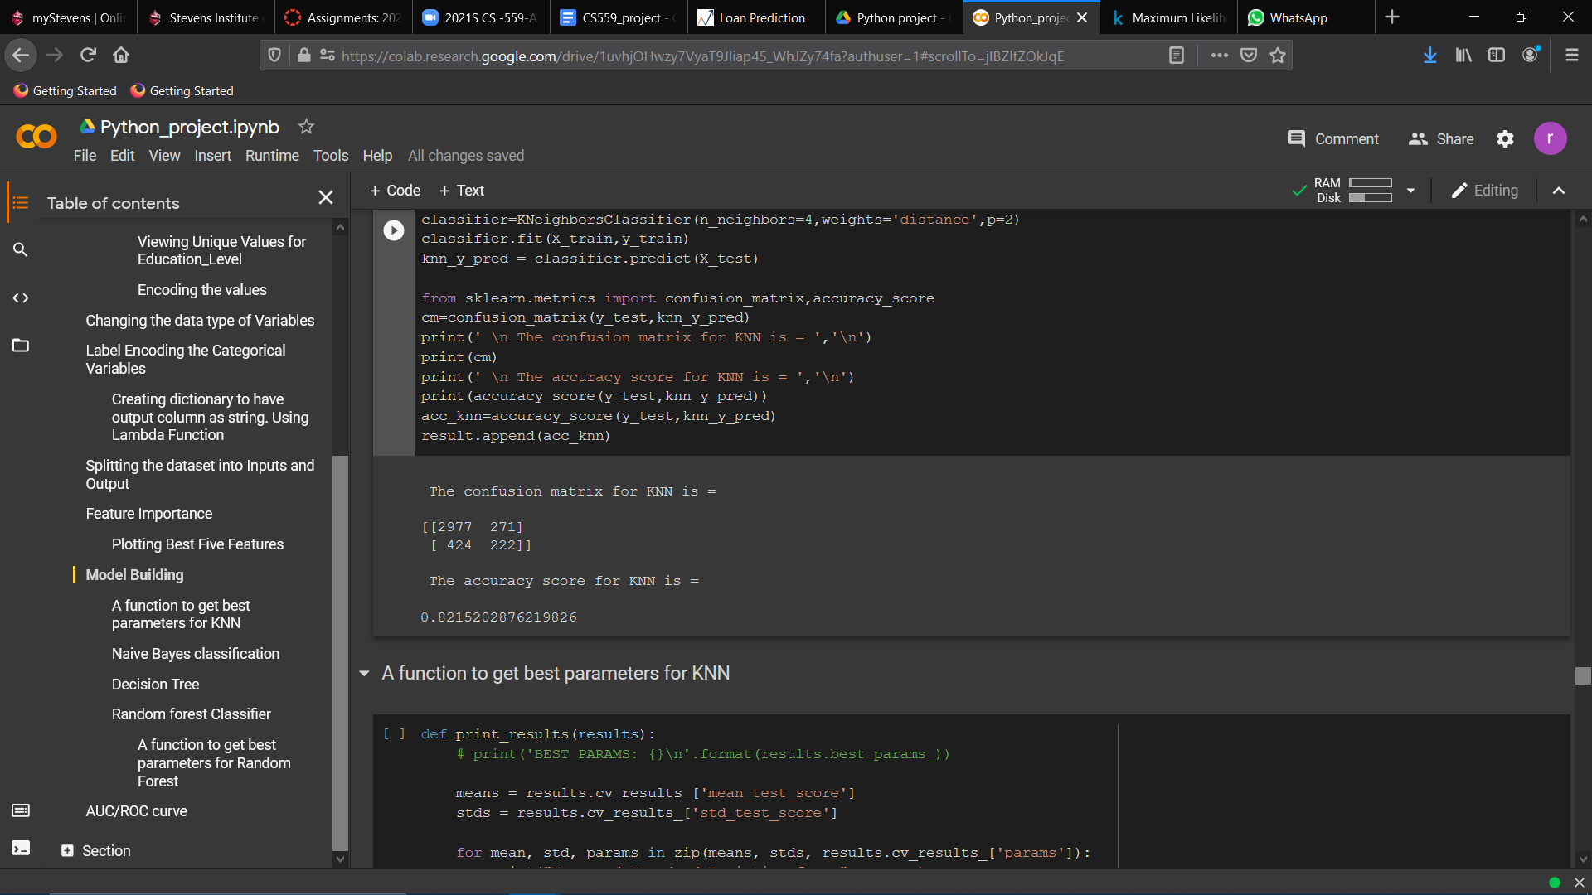
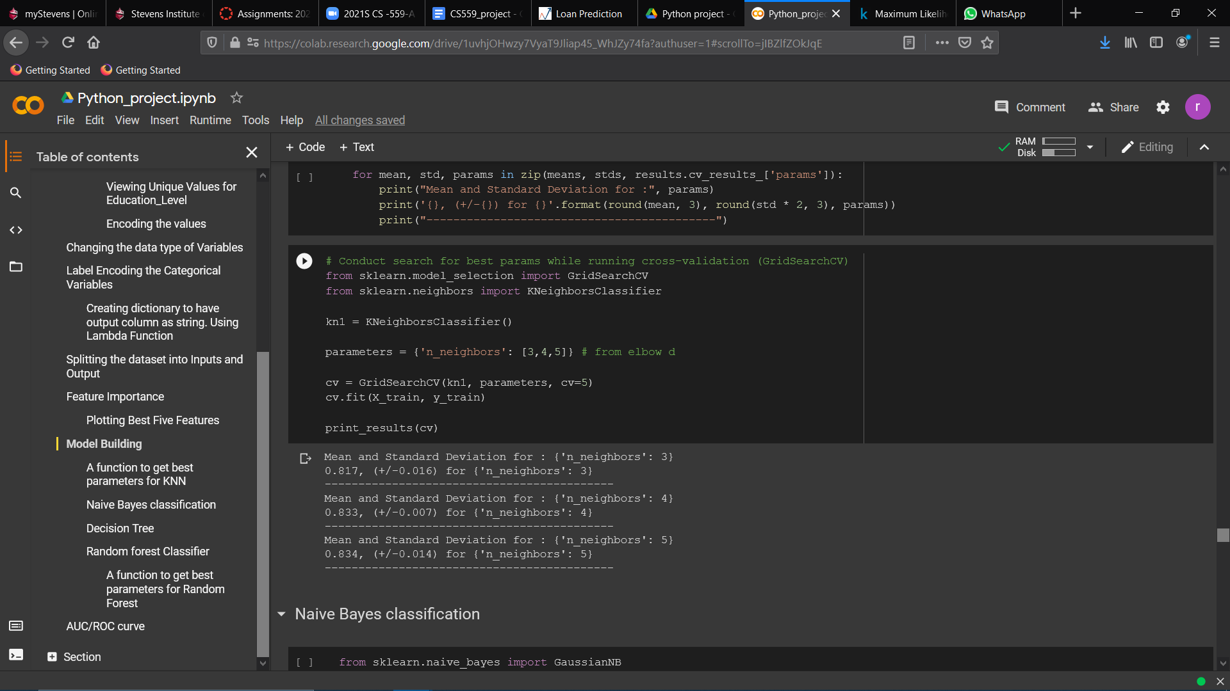
KNN
Elbow Method to find optimal k Confusion Matrix and Accuracy Score
Best K parameter based on Grid Search Cross Validation : CV=5
Notes:
iterated through various values of k - 3,4 5
concluded that n=5 is better
first implementing knn
most important step is is to select the value of k
can be decided with elbow dia
higher accuracy for 5

Slide 15
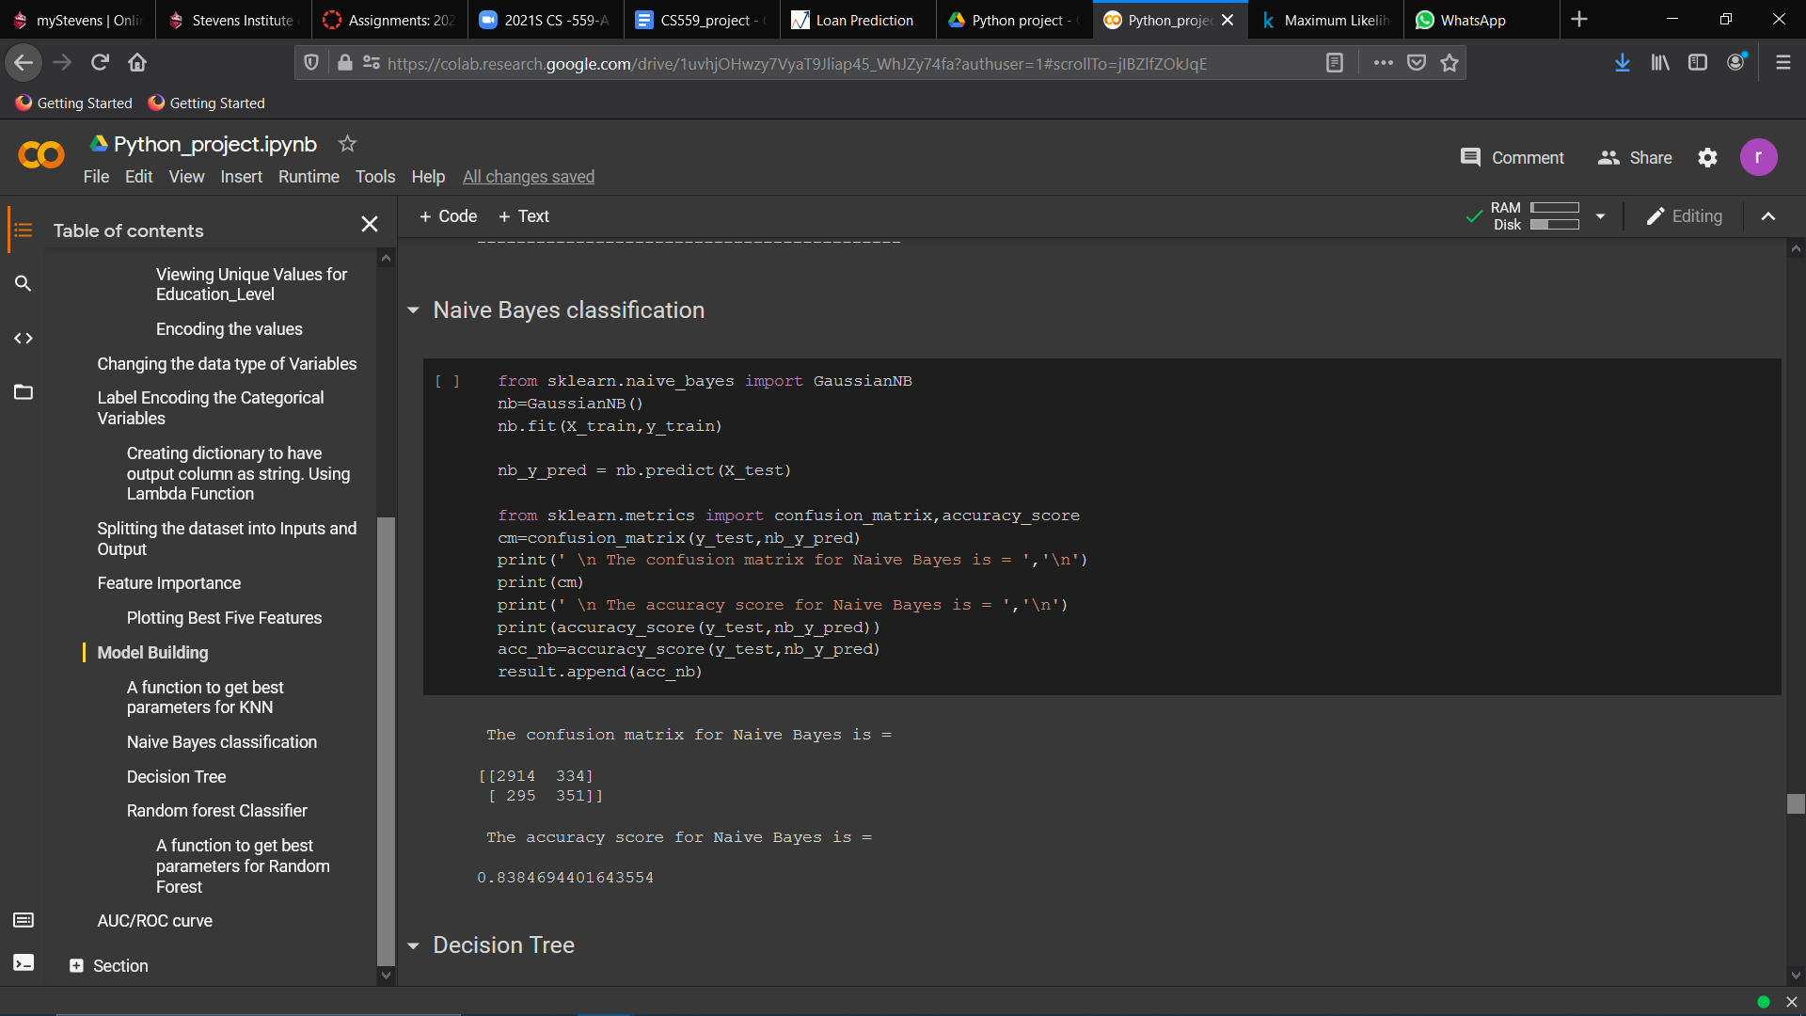
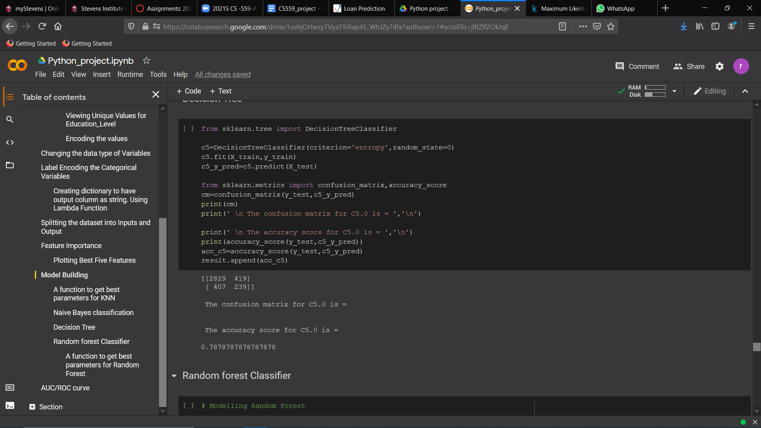
Naive Bayes
Decision Tree
Notes:
naive bayes -> on probability
accuracy score and confusion matrix are the evaluation matrices
for decision tree and obtained accuracy
DT < NB

Slide 16
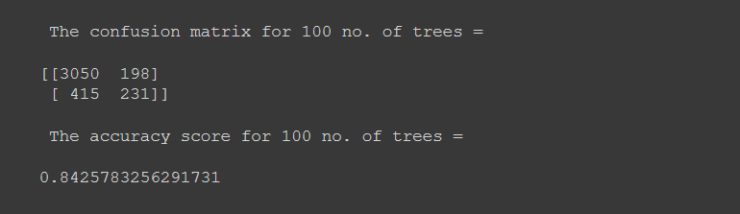
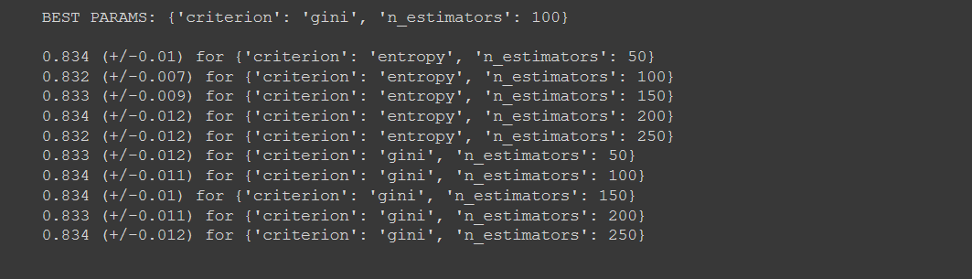
Random forest
Confusion Matrix and Accuracy Score for 100 trees
Best parameter based on Grid Search Cross Validation : CV=5
Notes:
ensemble algorithms
stack multiple decision trees.
grid search cv
83.4 is the best accuracy
optimal value chosen by algo.

Slide 17
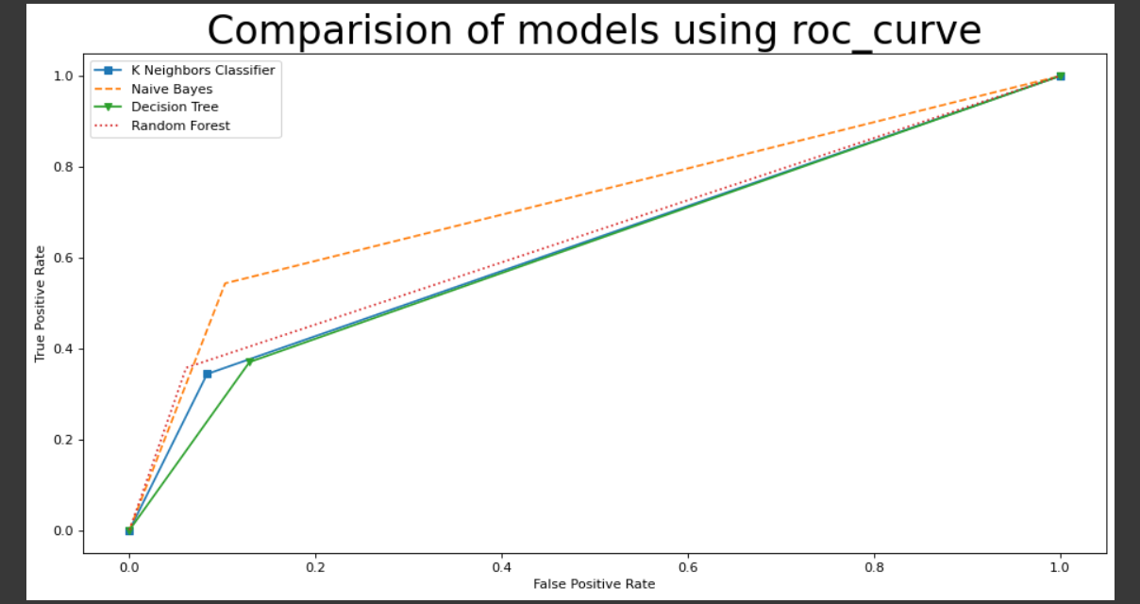
Comparison of Model Based On ROC Using Matplotlib Library
Notes:
plots accuracy of all algorithms
stored values in dictionaries

Slide 18
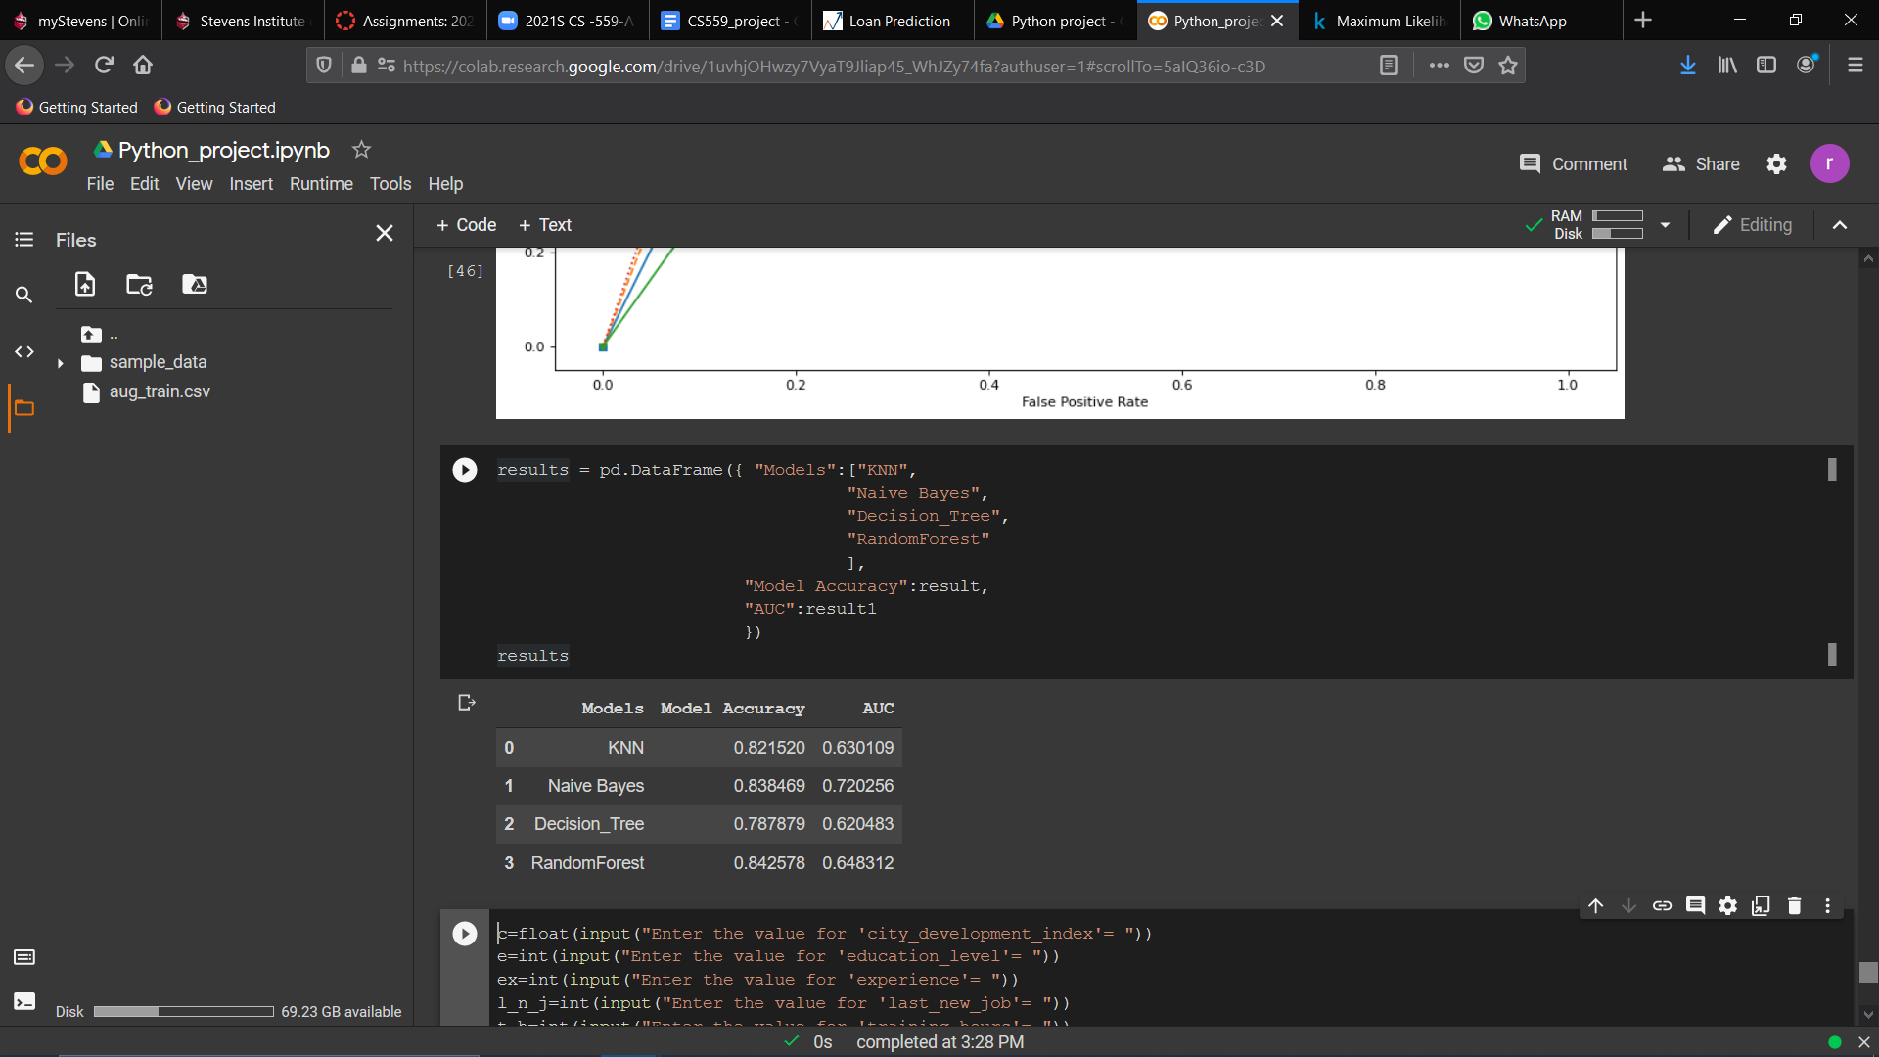
Model Accuracy and AUC Using Pandas Dataframe
Notes:
random forest performs is better -> model accuracy
auc -> naive bayes

Slide 19

ok but, which model to choose?

Slide 20

Conclusion
Based on accuracy as evaluation metric Random Forest Classifier performs best.
Based on ROC/AUC as evaluation metric Naive Bayes is the ideal model for prediction.
Notes:
based on requirement we can choose model

Slide 21
Project Workflow
Asking the right question
Preparing Data
Selecting the algorithm
Training the model
Testing the model

Slide 22
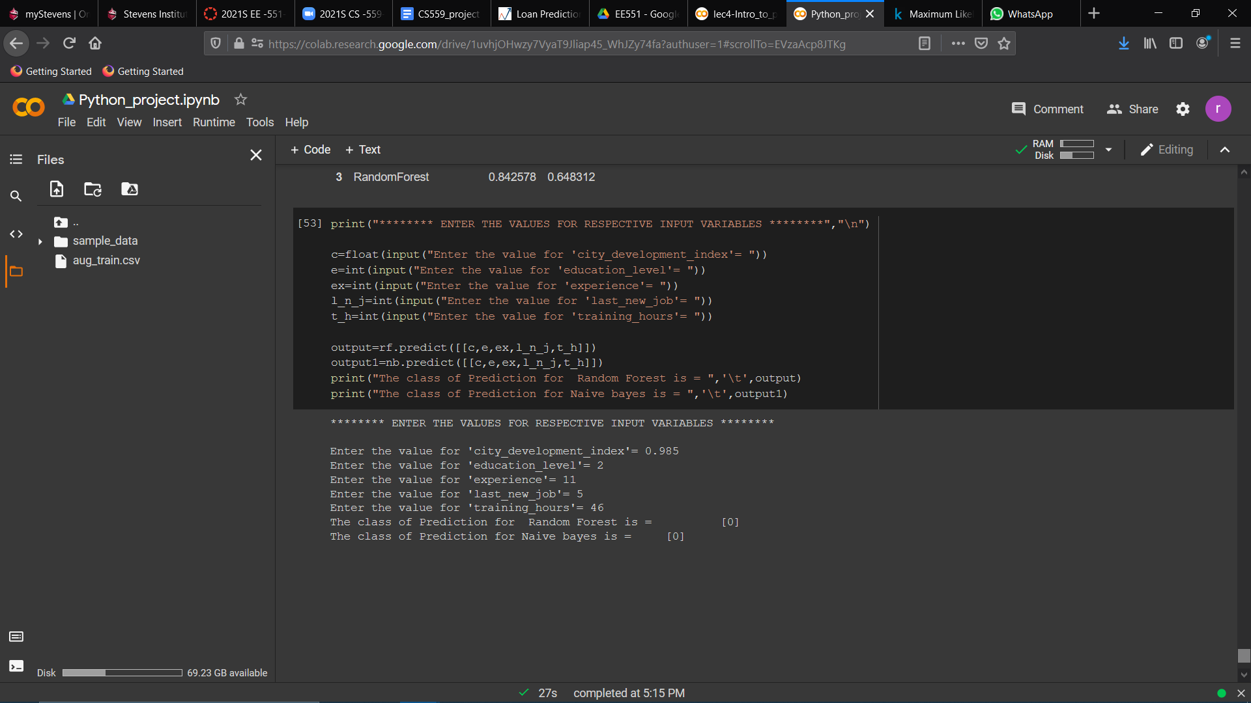
Testing on User input values
Notes:
trying to predict for the new value.
0 -> not leave the company

Slide 23


